Slide 1
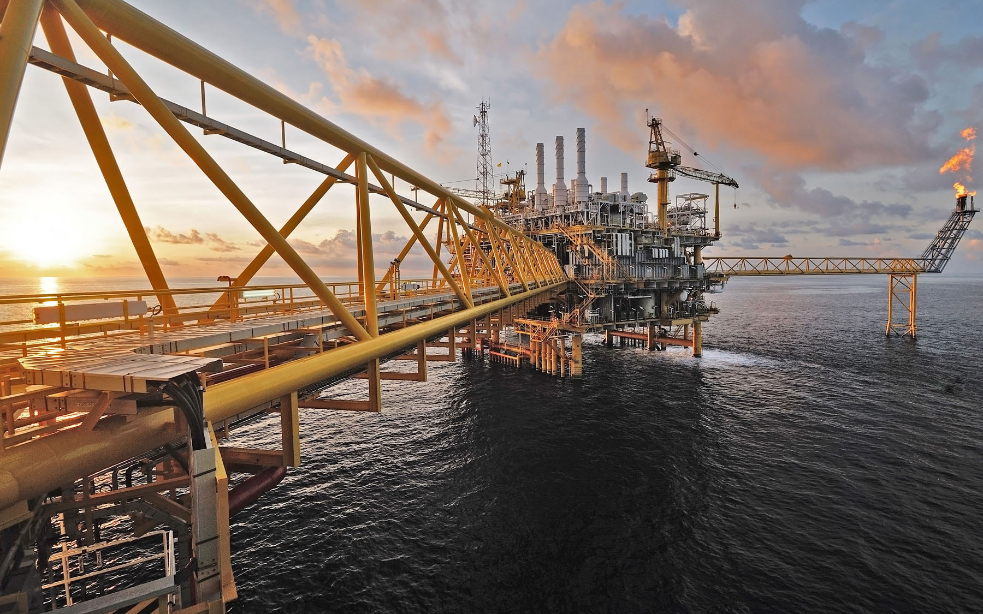


Structural Integrity Management System (SIMS) – Phase 1: Initiation
SIMS Dashboard Development
Badak LNG Plant Site, Bontang
PT. Badak NGL
Prepared by : WHC
Rev B / 20260706
PT. DINAMIKA TEKNIK PERSADA
Engineering Consultants
www.dtp-eng.com

Slide 2
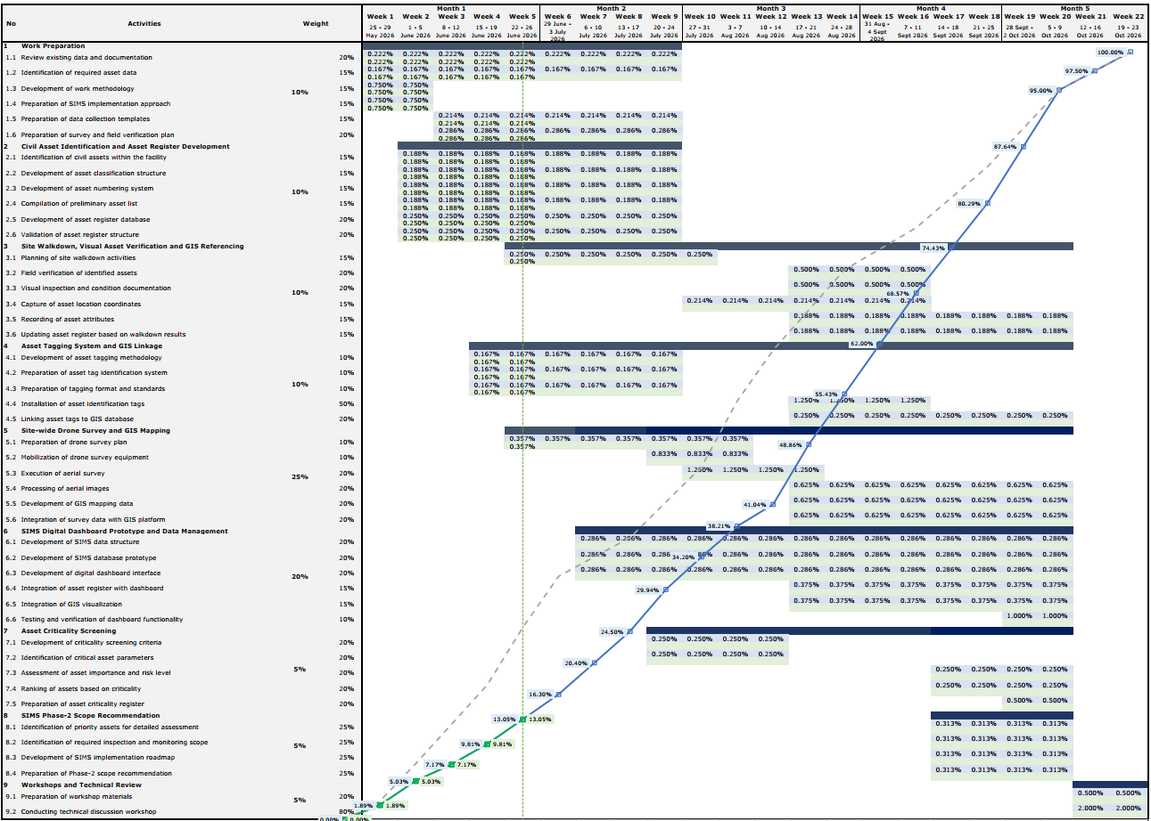
Notes:
Halaman Sign in

Slide 3
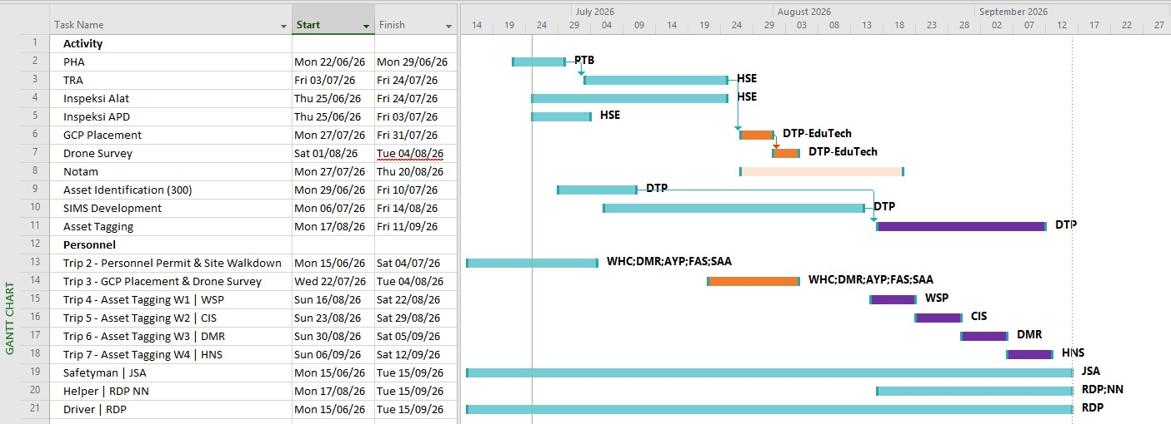
Important Date
Asset Identification (300 ea) : 29 June – 10 July 2026
SIMS Development : 6 July – 14 August 2026
Go online (Mock up) : 13 July 2026
Input asset register (300 ea) : up to 7 August 2026
Print name tag : 10 – 14 August 2026
Asset tagging (300 ea) : 17 August – 11 September 2026
Notes:
Halaman Sign in

Slide 4
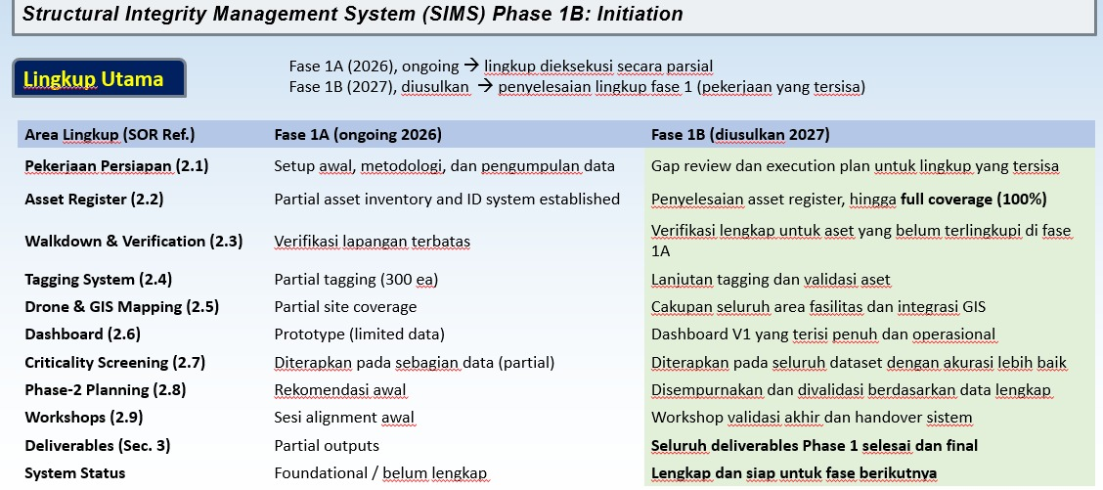
Prepare budgetary Quotation for next phase
Phase 1A | Phase 1B | Phase 2 | Phase 3 | Phase 4 | Phase 5
Asset register Tagging Critical screening (condition, GVI) | Additional feature requested by PTB | Criticality matrix >>> Risk Based Inspection Full GIS Mapping | Monitoring device Long term rehabilitation plan >>> Anomaly register and action plan | Full Integration Cross platform system integration Training | Validation handover

Slide 5

Structural Integrity Management System (SIMS)
Sign in to start your session
User Name
Password
Rember Me
Sign in
Notes:
Halaman Sign in

Slide 6
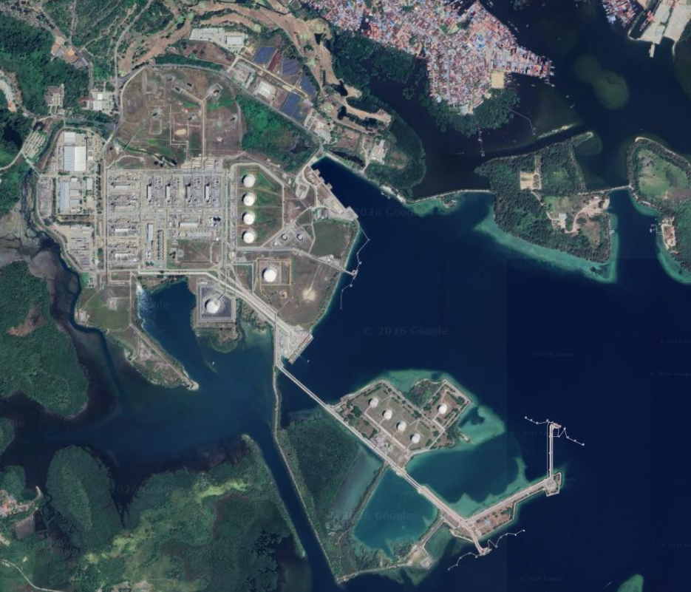
Structural Integrity Management System (SIMS)
Home
Asset Register
Risk Based Inspection Planning
Add
Module
Account Manager
Help
Logout
Asset Tree
Badak NGL
Summary
Summary
Summary
>Plant 1 Gas Purification Section
>Plant 2 Dehydration Section
>Plant 3 Fractionation Section
>Plant 4 Refrigeration Section
>Plant 5 Liquefaction Section
>Plant 6 Condensate Stripping ...
>Plant 15 LPG Section
>Plant 16 Condensate Stabilize ...
>Plant 17 LPG Storage and Loa …
>Plant 19 Relief & Blowdown S …
>Plant 20 Condensate Storage ...
20D-4/Q-1
20D-5/Q-1
20D-6/Q-1
+ add asset
>Plant 21 Feed Gas Knockout …
>Plant 22 Marine Structures
>Plant 24 LNG Storage and Loa …
>Plant 25 Fueling Facility
>Plant 26 LPG Filling Station … >Propane and Butane
>Plant 27 Oxygen Plant
>Plant 28 Acetylene Plant
>Plant 29 Nitrogen Generation
>Plant 30 Electrical Distributio …
>Plant 31 Steam & Power Gen …
>Plant 32 Seawater Cooling …
>Plant 33 Fire Protection System
>Plant 34 Liquid Waste System
>Plant 35 Compressed Air System
>Plant 36 Water Treatment Sy …
>Plant 37 Communication
>Plant 38 Inter-connecting
+ add Plant
All Plant
500
300
200
100
Good Fair Poor Unknown
Plant Summary
Plant 1
Plant 2
Plant 3
Plant 4
Plant 5
Plant 6
Plant 7
Plant 8
Plant 9
Plant 10
415
927
17
19
200
7
2
175
10
17
430
430
430
12
Notes:
Halaman dashboard / home
Action: N/A
Muncul peta Badak NGL keseluruhan

Slide 7
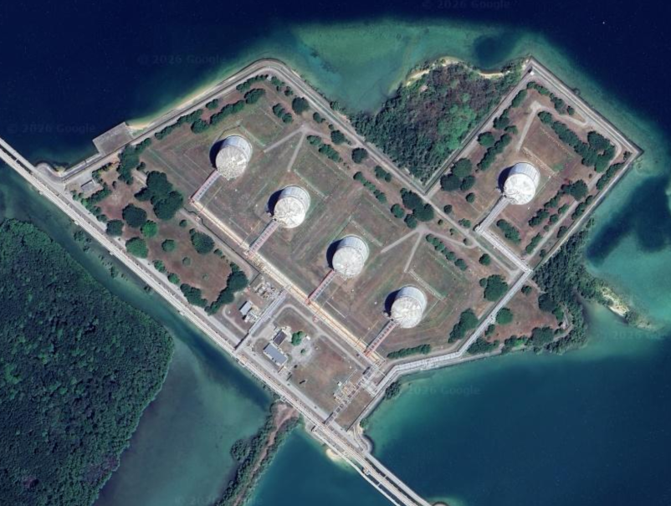

Structural Integrity Management System (SIMS)
Home
Asset Register
Risk Based Inspection Planning
Add
Module
Account Manager
Help
Logout
Asset Tree
Plant 17: LPG Storage and Loading
Description
Summary
>Plant 1 Gas Purification Section
>Plant 2 Dehydration Section
>Plant 3 Fractionation Section
>Plant 4 Refrigeration Section
>Plant 5 Liquefaction Section
>Plant 6 Condensate Stripping ...
>Plant 15 LPG Section
>Plant 16 Condensate Stabilize ...
>Plant 17 LPG Storage and Loa …
17D-1/Q-1
17D-2/Q-1
17D-3/Q-1
17D-4/Q-1
17D-5/Q-1
+ add asset
>Plant 19 Relief & Blowdown S …
>Plant 20 Condensate Storage ...
20D-4/Q-1
20D-5/Q-1
20D-6/Q-1
+ add asset
>Plant 21 Feed Gas Knockout …
>Plant 22 Marine Structures
>Plant 24 LNG Storage and Loa …
>Plant 25 Fueling Facility
>Plant 26 LPG Filling Station … >Propane and Butane
>Plant 27 Oxygen Plant
>Plant 28 Acetylene Plant
>Plant 29 Nitrogen Generation
>Plant 30 Electrical Distributio …
>Plant 31 Steam & Power Gen …
>Plant 32 Seawater Cooling …
>Plant 33 Fire Protection System
>Plant 34 Liquid Waste System
>Plant 35 Compressed Air System
>Plant 36 Water Treatment Sy …
>Plant 37 Communication
+ add Plant
Summary
Plant Code | 17
Plant Desc. | LPG Storage and Loading
17D-4/Q-1
17D-5/Q-1
17D-3/Q-1
17D-2/Q-1
17D-1/Q-1
Notes:
Halaman Dashboard
Action: Klik Spesfik Plant pada Asset Tree
Muncul lokasi pada peta asset-asset yang masuk dalam kelompok spesifik Plant

Slide 8
Structural Integrity Management System (SIMS)
B
Home
Asset Register
Risk Based Inspection Planning
Add
Module
Account Manager
Help
Logout
Asset Tree
17D-1/Q-1
Description
Summary
>Plant 1 Gas Purification Section
>Plant 2 Dehydration Section
>Plant 3 Fractionation Section
>Plant 4 Refrigeration Section
>Plant 5 Liquefaction Section
>Plant 6 Condensate Stripping ...
>Plant 15 LPG Section
>Plant 16 Condensate Stabilize ...
>Plant 17 LPG Storage and Loa …
17D-1/Q-1
17D-2/Q-1
17D-3/Q-1
17D-4/Q-1
17D-5/Q-1
+ add asset
>Plant 19 Relief & Blowdown S …
>Plant 20 Condensate Storage ...
20D-4/Q-1
20D-5/Q-1
20D-6/Q-1
+ add asset
>Plant 21 Feed Gas Knockout …
>Plant 22 Marine Structures
>Plant 24 LNG Storage and Loa …
>Plant 25 Fueling Facility
>Plant 26 LPG Filling Station … >Propane and Butane
>Plant 27 Oxygen Plant
>Plant 28 Acetylene Plant
>Plant 29 Nitrogen Generation
>Plant 30 Electrical Distributio …
>Plant 31 Steam & Power Gen …
>Plant 32 Seawater Cooling …
>Plant 33 Fire Protection System
>Plant 34 Liquid Waste System
>Plant 35 Compressed Air System
>Plant 36 Water Treatment Sy …
>Plant 37 Communication
+ add Plant
Summary
Asset register No. | 1
GIS Ref. No. | 1234567890
Asset tag no. | 17D-1/Q-1
Asset Description | Foundation for 17D-1
Plant | 17
Zone | Zone 1
Area | LPG Storage and Loading
Train | -
Coordinate | 1234567890 N | 1234567890 E
Installed | 1970 (age: 56 years)
Condition | Good
QR Code | http:www.dtp-eng.com |  | Preview
17D-1/Q-1
Asset Details
Notes:
Action: Klik Spesifik Asset pada Asset Tree
←||→ : Geser window
Peta menghilight specific asset
Kolom description menampilkan data umum asset.
Asset detail akan membawa ke menu asset details

Slide 9
Tabel Description
Mengambil/memanggil data Asset details > Asset register dan Asset details > Condition (GVI)
B
Asset details > Asset Register
Asset Register
Asset register No. | 1
GIS Ref. No. | 1234567890
Asset tag no. | 17D-1/Q-1
Plant code | 17 | LPG Storage and Loading
Asset Code Lv. 1 | D | Tanks
Asset Lv. 1 order | 1
Asset Lv. 1 desc. | Propane tank
Asset Code Lv. 2 | Q | Foundation
Asset Lv. 2 order | 1
Asset Lv. 2 desc. | Foundation for 17D-1
QR Code | http: www.dtp-eng.com | ↑ |  | Preview
Asset Attribute
Function | Equipment foundation
Material | Reinforced concrete
Year Installed | 1970 (age: 56 year)
Owner | PT. Badak NGL
Constrain | N/A
Access | Road
Location
Coordinate | 1234567890 N |  | 1234567890 E
Plant | 17
Zone | Zone 1
Area | LPG Storage and Loading
Train | N/A
Asset register No. | 1
GIS Ref. No. | 1234567890
Asset tag no. | 17D-1/Q-1
Asset Description | Foundation for 17D-1
Plant | 17
Zone | Zone 1
Area | LPG Storage and Loading
Train | -
Coordinate | 1234567890 N | 1234567890 E
Installed | 1970 (age: 56 years)
Condition | Good
QR Code | http:www.dtp-eng.com |  | Preview
Asset details > Condition (GVI)
Date of Inspection | 15/Aug/2026
Inspector | James Bond
Condition | Good
Comment | Structure is in good condition Minor coating degradation
Preview

Slide 10
Structural Integrity Management System (SIMS)
B
Home
Asset Register
Risk Based Inspection Planning
Add
Module
Account Manager
Help
Logout
Asset Tree
17D-1/Q-1
Asset Register | Condition (GVI) | Inspection | Risk Based Inspection | Technical Document | Documentation | Name Plate
>Plant 1 Gas Purification Section
>Plant 2 Dehydration Section
>Plant 3 Fractionation Section
>Plant 4 Refrigeration Section
>Plant 5 Liquefaction Section
>Plant 6 Condensate Stripping ...
>Plant 15 LPG Section
>Plant 16 Condensate Stabilize ...
>Plant 17 LPG Storage and Loa …
17D-1/Q-1
17D-2/Q-1
17D-3/Q-1
17D-4/Q-1
17D-5/Q-1
+ add asset
>Plant 19 Relief & Blowdown S …
>Plant 20 Condensate Storage ...
20D-4/Q-1
20D-5/Q-1
20D-6/Q-1
+ add asset
>Plant 21 Feed Gas Knockout …
>Plant 22 Marine Structures
>Plant 24 LNG Storage and Loa …
>Plant 25 Fueling Facility
>Plant 26 LPG Filling Station … >Propane and Butane
>Plant 27 Oxygen Plant
>Plant 28 Acetylene Plant
>Plant 29 Nitrogen Generation
>Plant 30 Electrical Distributio …
>Plant 31 Steam & Power Gen …
>Plant 32 Seawater Cooling …
>Plant 33 Fire Protection System
>Plant 34 Liquid Waste System
>Plant 35 Compressed Air System
>Plant 36 Water Treatment Sy …
>Plant 37 Communication
+ add Plant
Asset Register
Asset register No. | 1
GIS Ref. No. | 1234567890
Asset tag no. | 17D-1/Q-1
Plant code | 17 | LPG Storage and Loading
Asset Code Lv. 1 | D | Tanks
Asset Lv. 1 order | 1
Asset Lv. 1 desc. | Propane tank
Asset Code Lv. 2 | Q | Foundation
Asset Lv. 2 order. | 1
Asset Lv. 2 desc | Foundation for 17D-1
QR Code | http: www.dtp-eng.com | ↑ |  | Preview
Asset Attribute
Function | Equipment foundation
Material | Reinforced concrete
Year Installed | 1970 (age: 56 year)
Owner | PT. Badak NGL
Constrain | N/A
Access | Road
Location
Coordinate | 1234567890 N |  | 1234567890 E
Plant | 17
Zone | 1
Area | LPG Storage and Loading
Train | N/A
Edit
Notes:
Action: Klik Asset Details dari halaman sebelumnya
Menampilkan form detail asset berupa asset register, asset attribute, dan lokasi.
Untuk inputan QR Code memerlukan diskusi dengan mas Gadael/mas Philip/mas Aldi, apakah di generate otomatis dalam SIMS atau di generate dilaur sims dan di input dalam sims.

Slide 11
Structural Integrity Management System (SIMS)
B
Home
Asset Register
Risk Based Inspection Planning
Add
Module
Account Manager
Help
Logout
Asset Tree
17D-1/Q-1
Asset Register | Condition (GVI) | Inspection | Risk Based Inspection | Technical Document | Documentation | Name Plate
>Plant 1 Gas Purification Section
>Plant 2 Dehydration Section
>Plant 3 Fractionation Section
>Plant 4 Refrigeration Section
>Plant 5 Liquefaction Section
>Plant 6 Condensate Stripping ...
>Plant 15 LPG Section
>Plant 16 Condensate Stabilize ...
>Plant 17 LPG Storage and Loa …
17D-1/Q-1
17D-2/Q-1
17D-3/Q-1
17D-4/Q-1
17D-5/Q-1
+ add asset
>Plant 19 Relief & Blowdown S …
>Plant 20 Condensate Storage ...
20D-4/Q-1
20D-5/Q-1
20D-6/Q-1
+ add asset
>Plant 21 Feed Gas Knockout …
>Plant 22 Marine Structures
>Plant 24 LNG Storage and Loa …
>Plant 25 Fueling Facility
>Plant 26 LPG Filling Station … >Propane and Butane
>Plant 27 Oxygen Plant
>Plant 28 Acetylene Plant
>Plant 29 Nitrogen Generation
>Plant 30 Electrical Distributio …
>Plant 31 Steam & Power Gen …
>Plant 32 Seawater Cooling …
>Plant 33 Fire Protection System
>Plant 34 Liquid Waste System
>Plant 35 Compressed Air System
>Plant 36 Water Treatment Sy …
>Plant 37 Communication
+ add Plant
Asset Register
Asset register No. | <auto numbering>
GIS Ref. No. | <number>
Asset tag no. | <auto generate tag number>
Plant code | <Plant code selection> | <Look up plant code>
Asset Code Lv. 1 | <Asset Code Selection> | <Look up asset code>
Asset Lv. 1 order | <number>
Asset Lv. 1 desc. | <Text>
Asset Code Lv. 2 | <Civil code Selection> | <Look up asset code>
Asset Lv. 2 order. | <number>
Asset Lv. 2 desc | <text>
QR Code | <text> |  |  | <Select file>
Asset Attribute
Function | <Function selection>
Material | <Material selection>
Year Installed | <Number>
Owner | <Text>
Constrain | <Text>
Access | <Access selection>
Location
Coordinate | <Number> N |  | <Number> E
Plant | <refer to plant code>
Zone | <Number>
Area | <Text>
Train | <Text>
Save
Notes:
Action: Klik Edit pada halaman sebelumnya

Slide 12
Label : Asset Tag No.
Feature: : Auto generate tag number
Formula:
=concat
<Plant code> <Asset Code Lv. 1> ”-” <Asset Lv. 1 Order> “/” <Asset Code Lv. 2> “-” <Asset Lv. 2 Order>
Result Example:
17D-5/Q-1
B
Asset Register
Asset register No.
GIS Ref. No.
Asset tag no. | <auto generate tag number>
Plant code | 17
Asset Code Lv. 1 | D
Asset Lv. 1 Order | 5
Asset Lv. 1 Desc.
Asset Code Lv. 2 | Q
Asset Lv. 2 Order | 1
Asset Lv. Desc.
QR Code

Slide 13
Plant Code Selection | Description
1 | Gas Purification Section
2 | Dehydration Section
3 | Fractionation Section
4 | Refrigeration Section
5 | Liquifaction Section
6 | Condensate Stripping Section
15 | LPG Section
16 | Condensate Stabilizer Section
17 | LPG Storage and Loading
19 | Relief & Blowdown System
20 | Condensate Storage and Process LPG Storage
21 | Feed Gas Knockout Drum
22 | Marine Structures
24 | LNG Storage and Loading Facility
25 | Fueling Facility
26 | LPG Filling Station for Propane and Butane
27 | Oxygen Plant
28 | Acetylene Plant
29 | Nitrogen Generation
30 | Electrical Distribution Facilities
31 | Steam & Power Generation
32 | Seawater Cooling System
33 | Fire Protectuon System
34 | Liquid Waste System
35 | Compressed Air System
36 | Water Treatment System
37 | Communication
38 | Inter-connecting Pipeways
39 | Nitrogen Plant (Expansion)
40 | Site Preparation
41 | Buildings
42 | Building Equipment
43 | Tug Boats
48 | Community Facilities
49 | Community Facilities
50 | Plot Plans
51 | Mobile Equipment
52 | Distributed Control System
53 | Machinery Monitroing System
55 | Maps
57 | New 36 inch Pipeline
58 | 36 inch pipeline
59 | 42 inch pipeline
60 | 20 inch pipeline
61 | 16 inch pipeline
62 | 16 inch pipeline
63 | 6 inch pipeline
64 | Water Recreation Facilities
70 | Outside PT. Badak NGL Area
Label : Plant Code
Feature: : Drop Down Selection and Look Up
Asset Register
Asset register No.
GIS Ref. No.
Asset tag no.
Plant code | <Plant code Selection> | <Look up plant code>
Asset Code Lv. 1
Asset Lv. 1 order
Asset Lv. 1 desc.
Asset Code Lv. 2
Asset Lv. 2 order.
Asset Lv. 2 desc
QR Code
Example
Asset Register
Asset register No.
GIS Ref. No.
Asset tag no.
Plant code | 17 | LPG Storage and Loading
Asset Code Lv. 1
Asset Lv. 1 order
Asset Lv. 1 desc.
Asset Code Lv. 2
Asset Lv. 2 order.
Asset Lv. 2 desc
QR Code

Slide 14
Asset Code | Description
A | General
B | Process
C | Pressure Vessels
D | Tanks
E | Heat Exchangers
EM | Fan Motor
F | Fired Heaters
FX | Flame ignitor
G | Pumps
GA | Air motor driver for Pump
GE | Diesel Engine for Pump
GM | Electric Motor Driver for Pump
GT | Gas turbine
H | Vacuum
J | Instruments
KE | Diesel Engine Driver for Compressor
KG | Gear
KM | Electric Motor for Compressor
KT | Gas Turbine Driver for Compressor
KTM | Turning motor for compressor
KX | Clutch
L | Piping
LM | Motor for Valves
M | Structrue
N | Insulation
P | Electrical
PD | Battreies
PE | Diesel Engine Driver for Turbine generator
PG | Steam and Gas Turbine Generators
PGR | Ground System
PH | Electric Heater
PM | Motor control center for switchgear
PS | Switchgear
PSW | Primary Switch
PT | Transformer
PU | UPS Units
PUT | UPS Transformer
PY | Battery Charger
Q | Foundation
R | Buildings
S | Site Improvement
T | Material Handling Equipment
TM | Electric Motor for material handling equipment
TX | Bearing for material handling equipment
U | Expandables
V | Package Units
VG | Pump for package unit
VO | Valve Operators
VM | Electric Motor for Package Units
W | Welding and Metal Processing
X | Painting
Y | Processing
YM | Electric Motor for Processing Equipment
YX | Cylinder positioner driver for starting air system
Z | Water treating equipment
Label : Asset Code
Feature: : Drop Down Selection and Look Up
Asset Register
Asset register No.
GIS Ref. No.
Asset tag no.
Plant code
Asset Code Lv. 1 | <Asset code Selection> | <Look up Asset Code>
Asset Lv. 1 order
Asset Lv. 1 desc.
Asset Code Lv. 2 | <Asset code Selection> | <Look up Asset Code>
Asset Lv. 2 order.
Asset Lv. 2 desc
QR Code
Example
Asset Register
Asset register No.
GIS Ref. No.
Asset tag no.
Plant code
Asset Code Lv. 1 | D | Tanks
Asset Lv. 1 order
Asset Lv. 1 desc.
Asset Code Lv. 2 | Q | Foundation
Asset Lv. 2 order.
Asset Lv. 2 desc
QR Code

Slide 15
Label : Installed year
Feature: : Drop Down Selection and Look Up
Asset Attribute
Function | <Function selection>
Material | <Material selection>
Year Installed | <Number>
Owner | <Text>
Constrain | <Text>
Access | <Access selection>
Asset Attribute
Function | Equipment foundation
Material | Reinforced concrete
Year Installed | 1970 (age: 56 year)
Owner | PT. Badak NGL
Constrain | N/A
Access | Road
Age: Current date/year - Installed year
Notes:
Age di usulkan langsung muncul di sebelah year installed,
Altertnatifnya dibuatkan kolom tersendiri

Slide 16
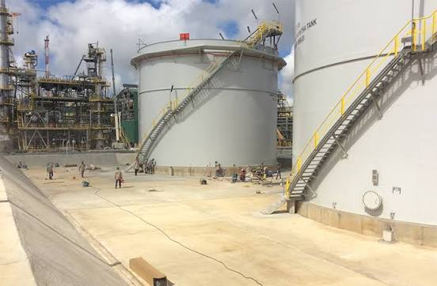

Structural Integrity Management System (SIMS)
Home
Asset Register
Risk Based Inspection Planning
Add
Module
Account Manager
Help
Logout
Asset Tree
17D-1/Q-1
Asset Register | Condition (GVI) | Inspection | Risk Based Inspection | Technical Document | Documentation | Name Plate
>Plant 1 Gas Purification Section
>Plant 2 Dehydration Section
>Plant 3 Fractionation Section
>Plant 4 Refrigeration Section
>Plant 5 Liquefaction Section
>Plant 6 Condensate Stripping ...
>Plant 15 LPG Section
>Plant 16 Condensate Stabilize ...
>Plant 17 LPG Storage and Loa …
17D-1/Q-1
17D-2/Q-1
17D-3/Q-1
17D-4/Q-1
17D-5/Q-1
+ add asset
>Plant 19 Relief & Blowdown S …
>Plant 20 Condensate Storage ...
20D-4/Q-1
20D-5/Q-1
20D-6/Q-1
+ add asset
>Plant 21 Feed Gas Knockout …
>Plant 22 Marine Structures
>Plant 24 LNG Storage and Loa …
>Plant 25 Fueling Facility
>Plant 26 LPG Filling Station … >Propane and Butane
>Plant 27 Oxygen Plant
>Plant 28 Acetylene Plant
>Plant 29 Nitrogen Generation
>Plant 30 Electrical Distributio …
>Plant 31 Steam & Power Gen …
>Plant 32 Seawater Cooling …
>Plant 33 Fire Protection System
>Plant 34 Liquid Waste System
>Plant 35 Compressed Air System
>Plant 36 Water Treatment Sy …
>Plant 37 Communication
+ add Plant
Date of Inspection | 15/Aug/2026
Inspector | James Bond
Condition | Good
Comment | Structure is in good condition Minor coating degradation
Preview
Edit
3 o/c Position
Notes:
Condition (GVI) bagian scope dalam SOR,
Tadinya mau di gabung dalam menu asset register, namun terlihat terlalu ramai, jadi diabuatkan menu tersendiri untuk mengakomodir lingkup kondisi.
Dalam menu ini user memasukkan input kondisi asset, catatan hasil inspeksi dan foto2 dokumentasi.

Slide 17
Structural Integrity Management System (SIMS)
Home
Asset Register
Risk Based Inspection Planning
Add
Module
Account Manager
Help
Logout
Asset Tree
17D-1/Q-1
Asset Register | Condition (GVI) | Inspection | Risk Based Inspection | Technical Document | Documentation | Name Plate
>Plant 1 Gas Purification Section
>Plant 2 Dehydration Section
>Plant 3 Fractionation Section
>Plant 4 Refrigeration Section
>Plant 5 Liquefaction Section
>Plant 6 Condensate Stripping ...
>Plant 15 LPG Section
>Plant 16 Condensate Stabilize ...
>Plant 17 LPG Storage and Loa …
17D-1/Q-1
17D-2/Q-1
17D-3/Q-1
17D-4/Q-1
17D-5/Q-1
+ add asset
>Plant 19 Relief & Blowdown S …
>Plant 20 Condensate Storage ...
20D-4/Q-1
20D-5/Q-1
20D-6/Q-1
+ add asset
>Plant 21 Feed Gas Knockout …
>Plant 22 Marine Structures
>Plant 24 LNG Storage and Loa …
>Plant 25 Fueling Facility
>Plant 26 LPG Filling Station … >Propane and Butane
>Plant 27 Oxygen Plant
>Plant 28 Acetylene Plant
>Plant 29 Nitrogen Generation
>Plant 30 Electrical Distributio …
>Plant 31 Steam & Power Gen …
>Plant 32 Seawater Cooling …
>Plant 33 Fire Protection System
>Plant 34 Liquid Waste System
>Plant 35 Compressed Air System
>Plant 36 Water Treatment Sy …
>Plant 37 Communication
+ add Plant
Date of Inspection | <Date>
Inspector | <Text>
Condition | <Condition Selection>
Comment | <Text>
Save
Description | File
<Text> | <Select file>
Add File

Slide 18
Label : Condition
Feature: : Drop Down Selection and color code
Date of Inspection | <Date>
Inspector | <Text>
Condition | <Condition Selection>
Comment | <Text>
Condition Selection | Color Code
Good
Fair
Poor

Slide 19

Structural Integrity Management System (SIMS)
Home
Asset Register
Account Manager
Help
Logout
Asset Tree
17D-1/Q-1
Asset Register | Condition (GVI) | Inspection | Risk Based Inspection | Technical Document | Documentation | Name Plate
>Plant 1 Gas Purification Section
>Plant 2 Dehydration Section
>Plant 3 Fractionation Section
>Plant 4 Refrigeration Section
>Plant 5 Liquefaction Section
>Plant 6 Condensate Stripping ...
>Plant 15 LPG Section
>Plant 16 Condensate Stabilize ...
>Plant 17 LPG Storage and Loa …
17D-1/Q-1
17D-2/Q-1
17D-3/Q-1
17D-4/Q-1
17D-5/Q-1
+ add asset
>Plant 19 Relief & Blowdown S …
>Plant 20 Condensate Storage ...
20D-4/Q-1
20D-5/Q-1
20D-6/Q-1
+ add asset
>Plant 21 Feed Gas Knockout …
>Plant 22 Marine Structures
>Plant 24 LNG Storage and Loa …
>Plant 25 Fueling Facility
>Plant 26 LPG Filling Station … >Propane and Butane
>Plant 27 Oxygen Plant
>Plant 28 Acetylene Plant
>Plant 29 Nitrogen Generation
>Plant 30 Electrical Distributio …
>Plant 31 Steam & Power Gen …
>Plant 32 Seawater Cooling …
>Plant 33 Fire Protection System
>Plant 34 Liquid Waste System
>Plant 35 Compressed Air System
>Plant 36 Water Treatment Sy …
>Plant 37 Communication
+ add Plant
Module Locked
Notes:
Inspection Module: Unlocked in the next project phase

Slide 20
Structural Integrity Management System (SIMS)
Home
Asset Register
Account Manager
Help
Logout
Asset Tree
17D-1/Q-1
Asset Register | Condition (GVI) | Inspection | Risk Based Inspection | Technical Document | Documentation | Name Plate
>Plant 1 Gas Purification Section
>Plant 2 Dehydration Section
>Plant 3 Fractionation Section
>Plant 4 Refrigeration Section
>Plant 5 Liquefaction Section
>Plant 6 Condensate Stripping ...
>Plant 15 LPG Section
>Plant 16 Condensate Stabilize ...
>Plant 17 LPG Storage and Loa …
17D-1/Q-1
17D-2/Q-1
17D-3/Q-1
17D-4/Q-1
17D-5/Q-1
+ add asset
>Plant 19 Relief & Blowdown S …
>Plant 20 Condensate Storage ...
20D-4/Q-1
20D-5/Q-1
20D-6/Q-1
+ add asset
>Plant 21 Feed Gas Knockout …
>Plant 22 Marine Structures
>Plant 24 LNG Storage and Loa …
>Plant 25 Fueling Facility
>Plant 26 LPG Filling Station … >Propane and Butane
>Plant 27 Oxygen Plant
>Plant 28 Acetylene Plant
>Plant 29 Nitrogen Generation
>Plant 30 Electrical Distributio …
>Plant 31 Steam & Power Gen …
>Plant 32 Seawater Cooling …
>Plant 33 Fire Protection System
>Plant 34 Liquid Waste System
>Plant 35 Compressed Air System
>Plant 36 Water Treatment Sy …
>Plant 37 Communication
+ add Plant
Module Locked
Notes:
Risk Based Inspection Module: Unlocked in the next project phase

Slide 21
Structural Integrity Management System (SIMS)
Home
Asset Register
Account Manager
Help
Logout
Asset Tree
17D-1/Q-1
Asset Register | Condition (GVI) | Inspection | Risk Based Inspection | Technical Document | Documentation | Name Plate
>Plant 1 Gas Purification Section
>Plant 2 Dehydration Section
>Plant 3 Fractionation Section
>Plant 4 Refrigeration Section
>Plant 5 Liquefaction Section
>Plant 6 Condensate Stripping ...
>Plant 15 LPG Section
>Plant 16 Condensate Stabilize ...
>Plant 17 LPG Storage and Loa …
17D-1/Q-1
17D-2/Q-1
17D-3/Q-1
17D-4/Q-1
17D-5/Q-1
+ add asset
>Plant 19 Relief & Blowdown S …
>Plant 20 Condensate Storage ...
20D-4/Q-1
20D-5/Q-1
20D-6/Q-1
+ add asset
>Plant 21 Feed Gas Knockout …
>Plant 22 Marine Structures
>Plant 24 LNG Storage and Loa …
>Plant 25 Fueling Facility
>Plant 26 LPG Filling Station … >Propane and Butane
>Plant 27 Oxygen Plant
>Plant 28 Acetylene Plant
>Plant 29 Nitrogen Generation
>Plant 30 Electrical Distributio …
>Plant 31 Steam & Power Gen …
>Plant 32 Seawater Cooling …
>Plant 33 Fire Protection System
>Plant 34 Liquid Waste System
>Plant 35 Compressed Air System
>Plant 36 Water Treatment Sy …
>Plant 37 Communication
+ add Plant
Module Locked
Notes:
Technical Document Module: Unlocked in the next project phase

Slide 22
Structural Integrity Management System (SIMS)
Home
Asset Register
Account Manager
Help
Logout
Asset Tree
17D-1/Q-1
Asset Register | Condition (GVI) | Inspection | Risk Based Inspection | Technical Document | Documentation | Name Plate
>Plant 1 Gas Purification Section
>Plant 2 Dehydration Section
>Plant 3 Fractionation Section
>Plant 4 Refrigeration Section
>Plant 5 Liquefaction Section
>Plant 6 Condensate Stripping ...
>Plant 15 LPG Section
>Plant 16 Condensate Stabilize ...
>Plant 17 LPG Storage and Loa …
17D-1/Q-1
17D-2/Q-1
17D-3/Q-1
17D-4/Q-1
17D-5/Q-1
+ add asset
>Plant 19 Relief & Blowdown S …
>Plant 20 Condensate Storage ...
20D-4/Q-1
20D-5/Q-1
20D-6/Q-1
+ add asset
>Plant 21 Feed Gas Knockout …
>Plant 22 Marine Structures
>Plant 24 LNG Storage and Loa …
>Plant 25 Fueling Facility
>Plant 26 LPG Filling Station … >Propane and Butane
>Plant 27 Oxygen Plant
>Plant 28 Acetylene Plant
>Plant 29 Nitrogen Generation
>Plant 30 Electrical Distributio …
>Plant 31 Steam & Power Gen …
>Plant 32 Seawater Cooling …
>Plant 33 Fire Protection System
>Plant 34 Liquid Waste System
>Plant 35 Compressed Air System
>Plant 36 Water Treatment Sy …
>Plant 37 Communication
+ add Plant
Module Locked
Notes:
Documentation Module: Unlocked in the next project phase

Slide 23



Structural Integrity Management System (SIMS)
Home
Asset Register
Risk Based Inspection Planning
Add
Module
Account Manager
Help
Logout
Asset Tree
17D-1/Q-1
Asset Register | Condition (GVI) | Inspection | Risk Based Inspection | Technical Document | Documentation | Name Plate
>Plant 1 Gas Purification Section
>Plant 2 Dehydration Section
>Plant 3 Fractionation Section
>Plant 4 Refrigeration Section
>Plant 5 Liquefaction Section
>Plant 6 Condensate Stripping ...
>Plant 15 LPG Section
>Plant 16 Condensate Stabilize ...
>Plant 17 LPG Storage and Loa …
17D-1/Q-1
17D-2/Q-1
17D-3/Q-1
17D-4/Q-1
17D-5/Q-1
+ add asset
>Plant 19 Relief & Blowdown S …
>Plant 20 Condensate Storage ...
20D-4/Q-1
20D-5/Q-1
20D-6/Q-1
+ add asset
>Plant 21 Feed Gas Knockout …
>Plant 22 Marine Structures
>Plant 24 LNG Storage and Loa …
>Plant 25 Fueling Facility
>Plant 26 LPG Filling Station … >Propane and Butane
>Plant 27 Oxygen Plant
>Plant 28 Acetylene Plant
>Plant 29 Nitrogen Generation
>Plant 30 Electrical Distributio …
>Plant 31 Steam & Power Gen …
>Plant 32 Seawater Cooling …
>Plant 33 Fire Protection System
>Plant 34 Liquid Waste System
>Plant 35 Compressed Air System
>Plant 36 Water Treatment Sy …
>Plant 37 Communication
+ add Plant
Foundation
for 17D-1
Tag no.: 17D-1/Q-1
Bridge 1
Tag no.: 17/M-1
Print
Print
Notes:
Menu name plate menampilkan preview name plate dengan memanggil item:
QR Code
Civil asset description
Civil Tag no.
Dan terdapat menu print untuk mencetak desain name plate

Slide 24
QR code dari specific asset
Foundation
for 17D-1
Tag no.: 17D-1/Q-1
Civil Asset Description dari specific asset
Asset tag no dari specific asset

Slide 25
Structural Integrity Management System (SIMS)
B
Home
Asset Register
Risk Based Inspection Planning
Add
Module
Account Manager
Help
Logout
Asset Tree
Asset Register
>Plant 1 Gas Purification Section
>Plant 2 Dehydration Section
>Plant 3 Fractionation Section
>Plant 4 Refrigeration Section
>Plant 5 Liquefaction Section
>Plant 6 Condensate Stripping ...
>Plant 15 LPG Section
>Plant 16 Condensate Stabilize ...
>Plant 17 LPG Storage and Loa …
17D-1/Q-1
17D-2/Q-1
17D-3/Q-1
17D-4/Q-1
17D-5/Q-1
+ add asset
>Plant 19 Relief & Blowdown S …
>Plant 20 Condensate Storage ...
20D-4/Q-1
20D-5/Q-1
20D-6/Q-1
+ add asset
>Plant 21 Feed Gas Knockout …
>Plant 22 Marine Structures
>Plant 24 LNG Storage and Loa …
>Plant 25 Fueling Facility
>Plant 26 LPG Filling Station … >Propane and Butane
>Plant 27 Oxygen Plant
>Plant 28 Acetylene Plant
>Plant 29 Nitrogen Generation
>Plant 30 Electrical Distributio …
>Plant 31 Steam & Power Gen …
>Plant 32 Seawater Cooling …
>Plant 33 Fire Protection System
>Plant 34 Liquid Waste System
>Plant 35 Compressed Air System
>Plant 36 Water Treatment Sy …
>Plant 37 Communication
+ add Plant
<Search Asset>
Search
Download
Reg no. | GIS Ref No. | Asset Tag No. | Asset Description | Plant | Zone | Area | Train | Coordinate | Function | Material | Installed | Age (yr) | Insp. Date | Condition (GVI)
1 | 12345… | 17D-1/Q-1 | Foundation for 17D-1 | 17 | Zone 1 | LPG Storage and Loading | - | 12345 N. 12345 E | Equipment Foundation | Reinforced Concrete | 1970 | 56 | 15/Aug/2026 | Good
Notes:
Asset Register
Menarik data seluruh asset badak yang sudah deregister.

Slide 26
[1] | [2] | [3] | [4] | [5] | [6] | [7] | [8] | [9] | [10] | [11] | [12] | [13] | [14] | [15]
Reg no. | GIS Ref No. | Asset Tag No. | Asset Description | Plant | Zone | Area | Train | Coordinate | Function | Material | Installed | Age (yr) | Insp. Date | Condition (GVI)
1 | 12345… | 17D-1/Q-1 | Foundation for 17D-1 | 17 | Zone 1 | LPG Storage and Loading | - | 12345 N. 12345 E | Equipment Foundation | Reinforced Concrete | 1970 | 56 | 15/Aug/2026 | Good
B
Column | Reference/source | Click Action | Feature
[1] | Asset register no. dari Specific asset | N/A | Filter, sorting
[2] | GIS Reference no. dari specific asset | N/A | Filter, sorting
[3] | Asset Tag no. dari specific asset | Hyperlink to specific asset | Filter, sorting
[4] | Civil Asset Description dari specific asset | N/A | Filter, sorting
[5] | Plant dari specific asset | N/A | Filter, sorting
[6] | Zone dari specific asset | N/A | Filter, sorting
[7] | Area dari specific asset | N/A | Filter, sorting
[8] | Train dari specific asset | N/A | Filter, sorting
[9] | Coordinate dari specific asset | N/A | Filter, sorting
[10] | Function dari specific asset | N/A | Filter, sorting
[11] | Material dari specific asset | N/A | Filter, sorting
[12] | Installed dari specific asset | N/A | Filter, sorting
[13] | Current date - Installed dari specific asset | N/A | Filter, sorting
[14] | Inspection Date dari specific asset | N/A | Filter, sorting
[15] | Condition dari specific asset | N/A | Filter, sorting

Slide 27
Structural Integrity Management System (SIMS)
Home
Asset Register
Risk Based Inspection Planning
Add
Module
Account Manager
Help
Logout
Asset Tree
Risk Based Inspection Planning
>Plant 1 Gas Purification Section
>Plant 2 Dehydration Section
>Plant 3 Fractionation Section
>Plant 4 Refrigeration Section
>Plant 5 Liquefaction Section
>Plant 6 Condensate Stripping ...
>Plant 15 LPG Section
>Plant 16 Condensate Stabilize ...
>Plant 17 LPG Storage and Loa …
17D-1/Q-1
17D-2/Q-1
17D-3/Q-1
17D-4/Q-1
17D-5/Q-1
+ add asset
>Plant 19 Relief & Blowdown S …
>Plant 20 Condensate Storage ...
20D-4/Q-1
20D-5/Q-1
20D-6/Q-1
+ add asset
>Plant 21 Feed Gas Knockout …
>Plant 22 Marine Structures
>Plant 24 LNG Storage and Loa …
>Plant 25 Fueling Facility
>Plant 26 LPG Filling Station … >Propane and Butane
>Plant 27 Oxygen Plant
>Plant 28 Acetylene Plant
>Plant 29 Nitrogen Generation
>Plant 30 Electrical Distributio …
>Plant 31 Steam & Power Gen …
>Plant 32 Seawater Cooling …
>Plant 33 Fire Protection System
>Plant 34 Liquid Waste System
>Plant 35 Compressed Air System
>Plant 36 Water Treatment Sy …
>Plant 37 Communication
+ add Plant
Module Locked
Notes:
Asset Register
Action: Klik Spesfik Plant pada Asset Tree

